Slide 1
GAME DESIGN PROPOSAL
RAVEN MORTIMER
&
BUU NGUYEN

Slide 2
IDEA 01

Slide 3
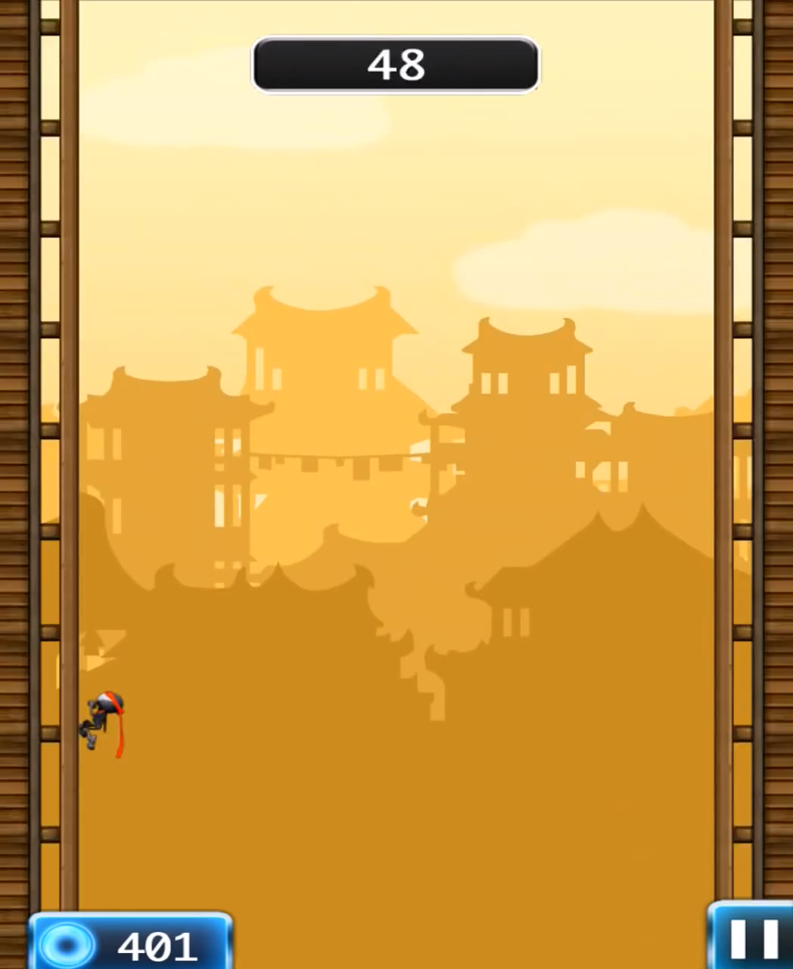
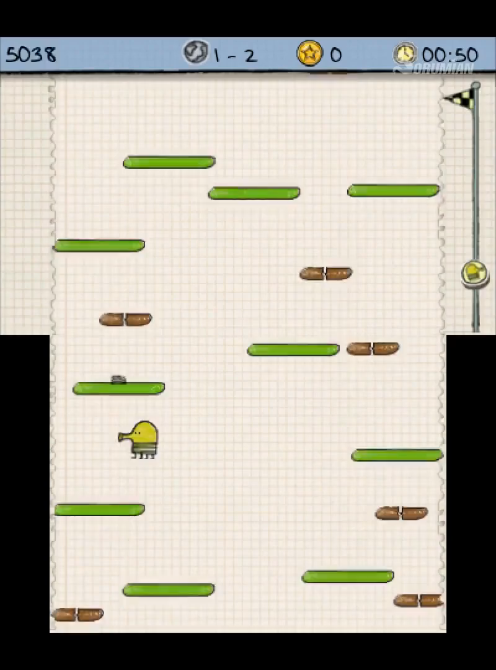
2D ENDLESS JUMPER

Slide 4
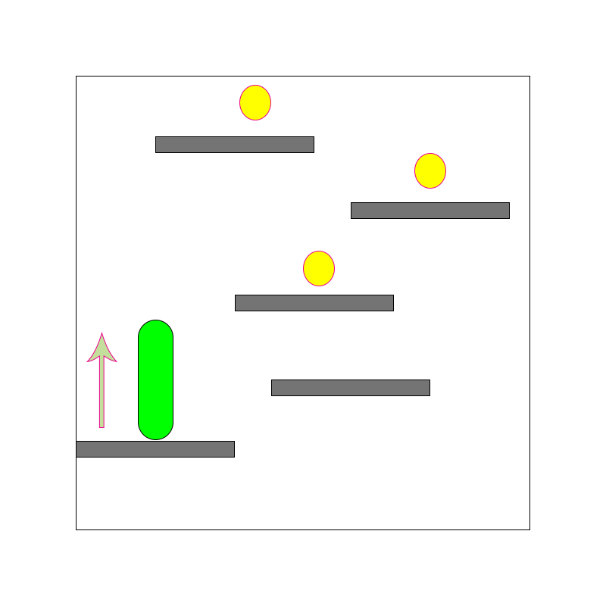
iJump
Endless jump
Power-up pick up
Money pick up
Booster Shop
High Score Record

Slide 5
CHALLENGES
Not yet decided theme and setting.
Randomize Tile/Platform Generator scaling with increasing Score at run time.
Difficulty balancing.
Maintaining a consistent art style; making sure everything looks coherent together.
Creating fitting and high-quality music and sounds

Slide 6
Beat chart

Slide 7
Code Architecture

Slide 8
Working Platform

